Slide 1
Assignment-II
AUCTION WEBSITE
AKANSHA
2310993769
Submitted to:
Dr. Swati Malik
Chitkara University Institute of Engineering and Technology,
Chitkara University, Punjab

Slide 2
Table of Contents
Introduction
Methodology
Tools and Technologies
Major Findings/Outcomes/Output/Results
Conclusion and Future Scope
References
Appendices

Slide 3
Introduction
In the age of digital innovation, education undergoes a profound transformation, propelled by the convergence of technology and pedagogy. The advent of the E-COMMERCE WEBSITE, underpinned by the versatile Django framework, heralds a new chapter in this evolution..
The essence of the E-commerce website lies in its simplicity and versatility. E-commerce application using Django involves several steps, each contributing to the development of a robust and functional platform.
By harnessing the capabilities of Django, it offers a scalable, customizable, and user-centric solution to the evolving needs of modern learners and educators. It provides the brief overview of Django as ahigh-level Python web framework. Django follows the Model-View-Template (MVT) architecture, facilitating the development of complex web applications like e-commerce platform.
Explain the role of views in handling user requests and rendering dynamic content. Discuss the use of Django templates for generating HTML output based on data passed from views. Illustrate how to create views and templates for displaying product listings, product details, shopping cart, and checkout pages.
Summarize the key points discussed in the report. Reflect on the significance of Django as a framework for developing e-commerce applications.
Discuss future enhancements and areas for further exploration in e-commerce application development using Django.

Slide 4
Methodology
1. Requirement Analysis : Conduct a comprehensive analysis to understand the specific needs and expectations of the users, including costumers, sellers and buyers. Define the features and functionalities required for post list, activating list, login, registration and wishlist
2.Design Phase: Utilize user-centric design principles to create an intuitive and visually appealing interface for the E-Commerce website. Design wireframes and prototypes to conceptualize the user journey, ensuring seamless navigation and interaction.
3.Database Design: Design a robust database schema to store user information, lists, and related metadata. Choose appropriate database technologies to ensure scalability, performance, and data integrity
4.Backend Development: Implement the backend logic using Django, leveraging its powerful features such as models, views, and serializers. Develop APIs for note creation, retrieval, deletion, and editing, adhering to RESTful principles for interoperability and scalability.
5.Frontend Development: Develop the frontend components using HTML, CSS, and JavaScript frameworks such as React or Vue.js. Implement interactive interfaces for entering, deleting, and editing lists of products, incorporating feedback mechanisms for user engagement.
6.Authentication and Authorization: Implement a secure authentication system using Django's built-in authentication framework. Define role-based access controls to ensure that only authorized users can perform note-related actions.

Slide 5
Tools and Technologies
For the E-commerce website project, several tools, technologies, and terminologies are essential for its development and deployment. Here's a list:
Django: A high-level Python web framework that facilitates rapid development and clean, pragmatic design. Django provides a robust foundation for building web applications, including features such as authentication, URL routing, and database integration.
HTML, CSS, JavaScript: Fundamental web development technologies used for creating the frontend interface of the E-commerce website. HTML defines the structure of web pages, CSS styles the layout and appearance, and JavaScript adds interactivity and dynamic behavior.
Python: Python is a high-level, interpreted programming language known for its simplicity and readability. It offers a vast ecosystem of libraries and frameworks, making it suitable for various applications, including web development. In the context of the E-commerce website project , Python serves as the primary language for backend development using the Django web framework.
SQLite: SQLite is a lightweight, serverless, relational database management system (RDBMS) that is embedded directly into the application. It provides a self-contained, file-based database engine, eliminating the need for a separate database server. SQLite is widely used in applications that require a local or small-scale database, such as mobile apps and desktop software.

Slide 6
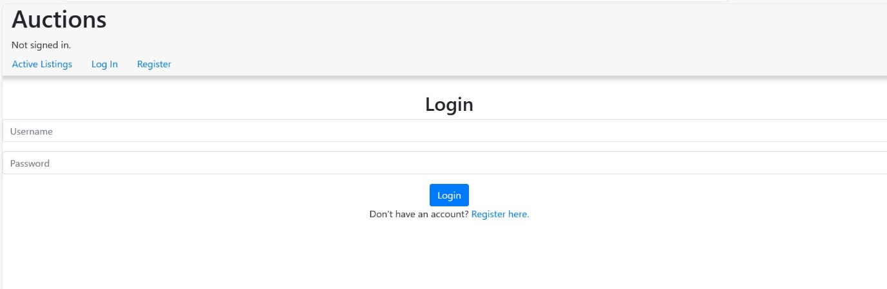
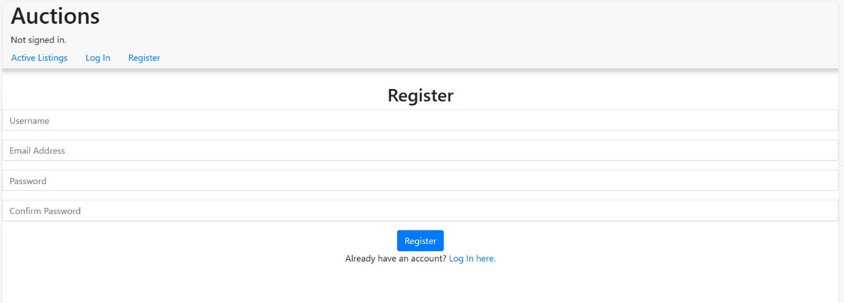
Findings

Slide 7
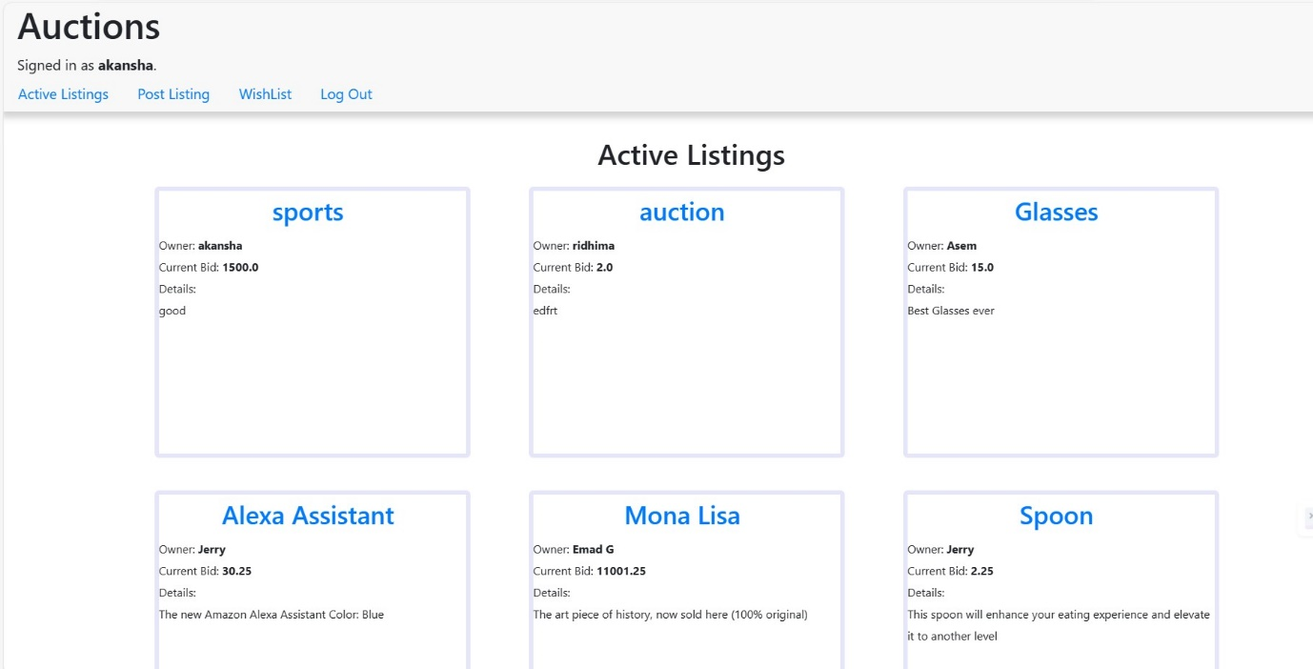
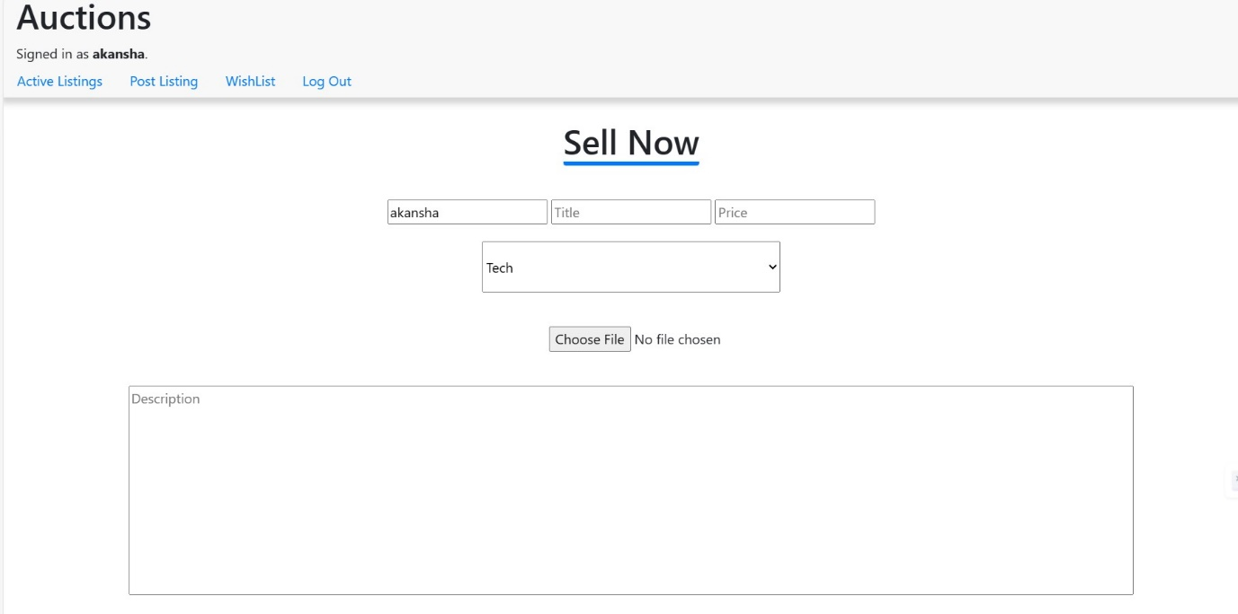
Findings

Slide 8
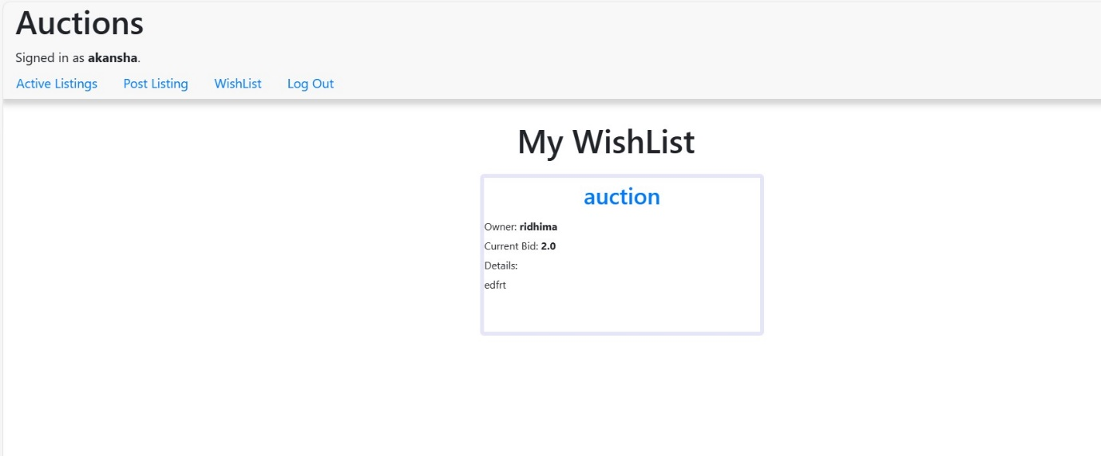
Findings

Slide 9
CONCLUSION AND FUTURE SCOPE
The E-commerce project, built with Django, Python, SQLite, and compatible with Microsoft Edge, marks a significant advancement in digital education. By offering a platform for entering, editing, and deleting list of products, it addresses the evolving needs of customers and sellers in an increasingly digital world. Leveraging the power of Django's robust backend framework, Python's simplicity, SQLite's efficiency, and Microsoft Edge's modern browsing capabilities, the project provides a seamless and user-friendly experience for managing industrial materials.
Scope : The scope of the E-commerce website project extends beyond its initial implementation. Here are some potential avenues for further development and enhancement:
1.Additional Features: Expand the functionality of the E-commerce website platform by incorporating features such as text formatting options, multimedia support, offline access, and integration with third-party services like Google Drive or Dropbox.
2.Enhanced Collaboration: Introduce real-time collaboration features, including simultaneous editing, functionality, and version control, to facilitate seamless collaboration among users.
3.Mobile Accessibility: Develop mobile applications for iOS and Android platforms, allowing users to access and manage their notes on the go using their smartphones or tablets.

Slide 10
References
1. Django Documentation: The official Django documentation provides comprehensive guides, tutorials, and references for building web applications with Django. It covers topics such as models, views, templates, forms, authentication, and deployment.
2. Python Documentation: The Python documentation offers detailed information about the Python programming language, including syntax, data structures, standard libraries, and best practices. It serves as a valuable resource for understanding Python's features and capabilities.
3. SQLite Documentation: The SQLite documentation provides documentation on using SQLite, including SQL syntax, data types, query optimization, and administration. It offers insights into leveraging SQLite effectively for database management in Django projects.
4. Microsoft Edge Developer Documentation: The Microsoft Edge developer documentation offers resources and guides for web developers targeting the Edge browser. It covers topics such as web standards, browser compatibility, developer tools, and best practices for web development.
5. Web Development Books and Tutorials: Various books and online tutorials cover web development concepts, frameworks, and technologies such as Django, Python, SQLite, and frontend development (HTML, CSS, JavaScript). These resources can provide in-depth insights and practical examples for building web applications.

Slide 11


